Slide 1
Realising the potential of audit and feedback
Robbie Foy
May 2017

Slide 2

Acknowledgement
This presentation summarises independent research funded by the National Institute for Health Research (NIHR) under its Programme Grants for Applied Research programme (Grant Reference Number RP-PG-1209-10040)
The views expressed are those of the authors and not necessarily those of the NHS, the NIHR or the Department of Health

Slide 3
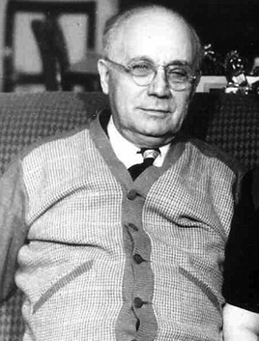
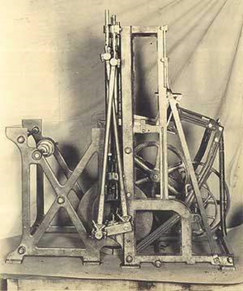

Otto Rohwedder

Slide 4

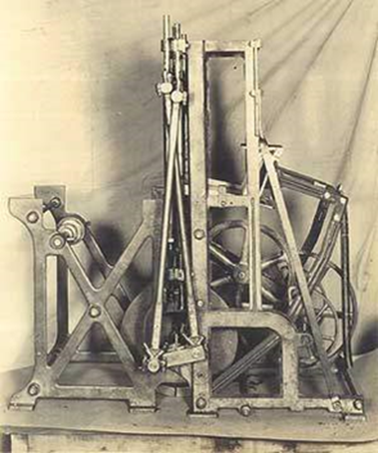
How long did it take for sliced bread to take off?
One year
Five years
Fifteen years
Fifty years

Slide 5
How long did it take for sliced bread to take off?
One year
Five years
Fifteen years
Fifty years
Notes:
So, when we say that new treatment X is the best thing since sliced bread, we cannot assume that it will get into practice rapidly.

Slide 6
Realising the potential of audit and feedback
Evidence-based audit and feedback
AFFINITIE and beyond
Effects of selected QI approaches

Slide 7
Realising the potential of audit and feedback
Evidence-based audit and feedback
AFFINITIE and beyond
Effects of selected QI approaches

Slide 8

Audit and feedback
Any summary of clinical performance of health care over a specified period of time. The summary may also have included recommendations for clinical action
Cochrane EPOC definition

Slide 9
QUIZ: What is the absolute effect of A&F in research settings?
<=0%
1-3%
4-6%
7-9%
>10%

Slide 10
QUIZ: What is the absolute effect of A&F in research settings?
<=0%
1-3%
4-6%
7-9%
>10%
All of the above!

Slide 11
Audit and feedback
140 trials of audit and feedback median absolute improvement +4% interquartile range +1% to +16%
Ivers et al. Cochrane Database
of Systematic Reviews 2012
Notes:
Anyone do this?
It works a bit – but what makes it work better?

Slide 12
Audit and feedback
140 trials of audit and feedback median absolute improvement +4% interquartile range +1% to +16%
Larger effects if:
Baseline compliance low
Source a supervisor or colleague
Feedback provided more than once
Feedback delivered in both verbal and written formats
Feedback included both explicit targets and an action plan
Ivers et al. Cochrane Database
of Systematic Reviews 2012
Notes:
Anyone do this?
It works a bit – but what makes it work better?

Slide 13
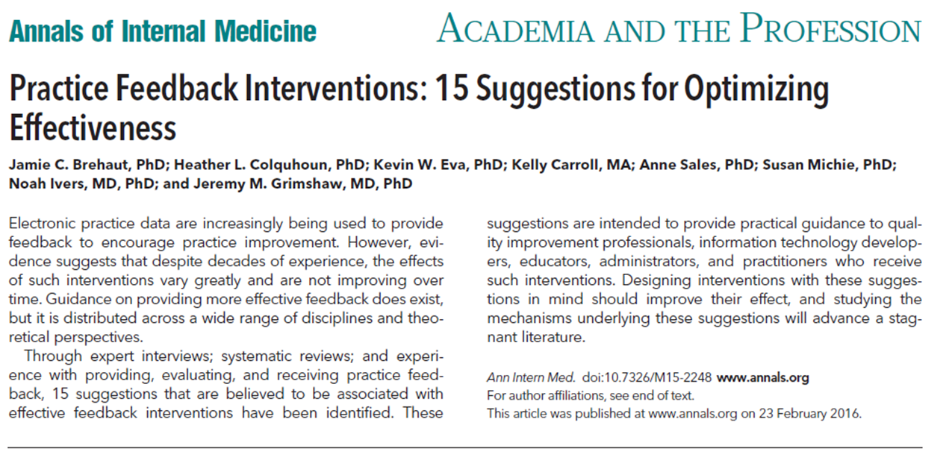
Suggestions for optimising the effectiveness of A&F

Slide 14
Suggestions for optimising the effectiveness of A&F
Nature of the desired action
Recommend actions that are consistent with established goals and priorities
Recommend actions that can improve and are under the recipient's control
Recommend specific actions

Slide 15
Suggestions for optimising the effectiveness of A&F
Nature of the data available for feedback
Provide multiple instances of feedback
Provide feedback as soon as possible and at a frequency informed by the number of new patient cases
Provide individual (e.g. practitioner specific) rather than general data
Choose comparators that reinforce desired behaviour change

Slide 16
Suggestions for optimising the effectiveness of A&F
Feedback display
Closely link the visual display and summary message
Provide feedback in more than one way
Minimize extraneous cognitive load for feedback recipients

Slide 17
Suggestions for optimising the effectiveness of A&F
Delivering the feedback intervention
Address barriers to feedback use
Provide short, actionable messages followed by optional detail
Address credibility of the information
Prevent defensive reactions to feedback
Construct feedback through social interaction

Slide 18
Realising the potential of audit and feedback
Evidence-based audit and feedback
AFFINITIE and beyond
Effects of selected QI approaches

Slide 19
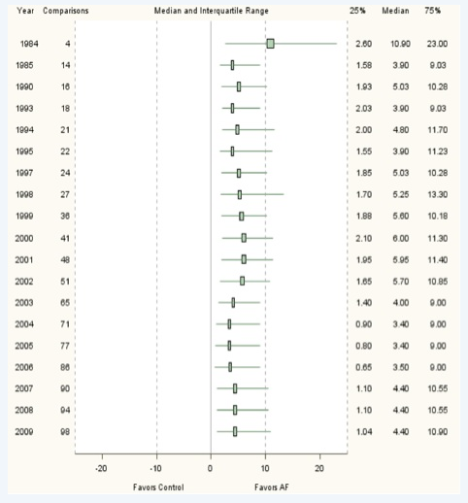
Growing Literature, Stagnant Science?
Cumulative analysis – effect size of audit and feedback interventions over time
Little evidence of formal replication - only 6 studies reported testing an intervention from a previous study
Ivers et al. J Gen Intern Med 2014
Notes:
Of the 140 randomized clinical trials (RCTs) included in the Cochrane review, 98 comparisons from 62 studies met the criteria for inclusion. The cumulative analysis indicated that the effect size became stable in 2003 after 51 comparisons from 30 trials. Cumulative meta-regressions suggested new trials are contributing little further information regarding the impact of common effect modifiers.

Slide 20
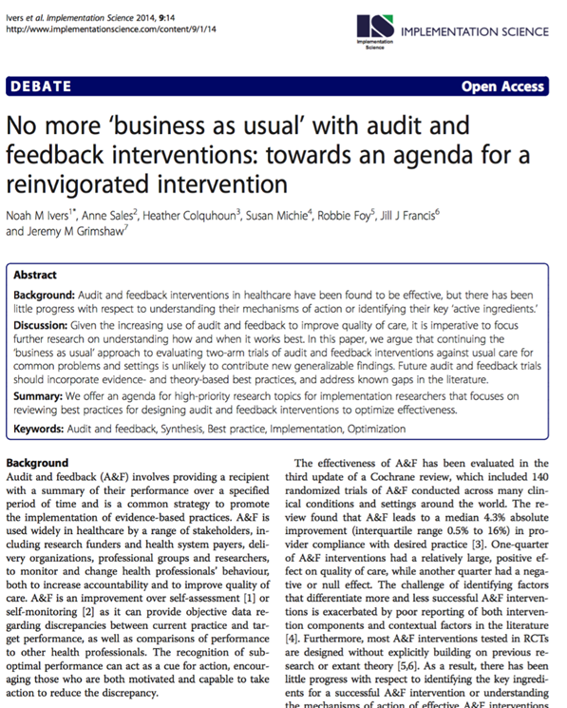
No more ‘business as usual’
Head-to-head arm trials evaluating:
alternative ways of designing and/or delivering audit and feedback
audit and feedback vs audit and feedback plus co-interventions
audit and feedback versus alternative interventions

Slide 21
Potential ways of varying feedback
Recommend actions that are consistent with established goals and priorities
Recommend actions that can improve and are under the recipient's control
Recommend specific actions
Provide multiple instances of feedback
Provide feedback as soon as possible and at a frequency informed by the number of new patient cases
Provide individual rather than general data
Choose comparators that reinforce desired behaviour change
Closely link the visual display and summary message
Provide feedback in more than one way
Minimize extraneous cognitive load for feedback recipients
Address barriers to feedback use
Provide short, actionable messages followed by optional detail
Address credibility of the information
Prevent defensive reactions to feedback
Construct feedback through social interaction

Slide 22
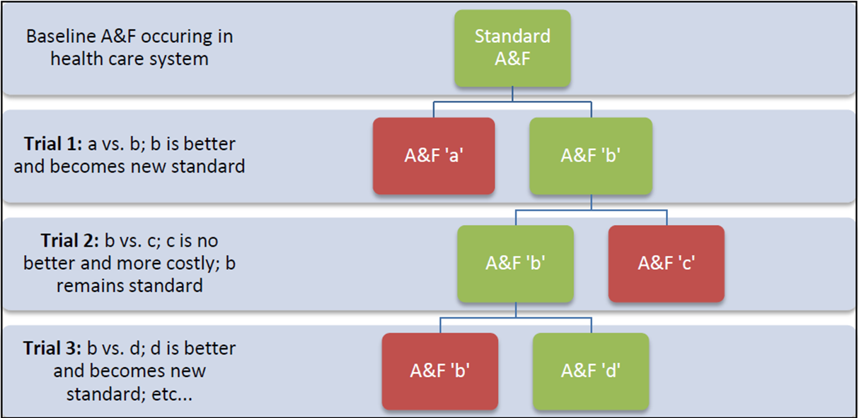
Implementation laboratories

Slide 23
Implementation laboratories
Benefits for health system
Learning organisation
Incremental and demonstrable quality improvement
Linkages to academic skills
Benefits for implementation science
Ability to test important (but potentially subtle) variations in audit and feedback that may have important effects
Ivers & Grimshaw. Lancet 2016; 388: 547-8

Slide 24

Enhanced audit and feedback interventions to increase the uptake of evidence-based transfusion practice
Stanworth S, Francis JJ, Foy R, Gould N, Lorencatto F, Farrin A, Hartley S, Morris S, Walwyn R, Grant-Casey J, Glidewell L, Cicero R, Deary A, Michie S, Murphy M
Notes:
An example of a laboratory

Slide 25



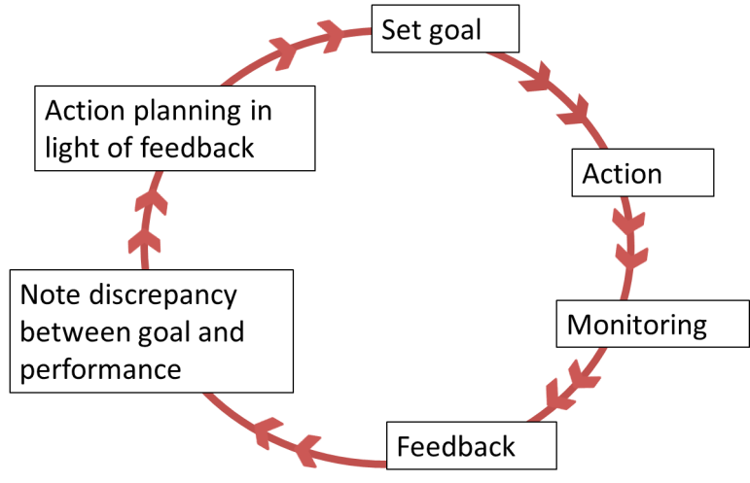


Notes:
Ongoing National Comparative Audit demonstrating overuse of blood products
Earlier work using TDF identified a number of key influences on practice, including behavioural regulation
‘Control theory’ (Carver & Scheier, 1998) most relevant to audit and feedback: people manage their behaviour by knowing what they want to do or achieve (setting a goal or standard), trying to do it (action), seeing whether they are making progress (feedback which informs as to the nature and extent of any discrepancy) and adapting what they do in the light of the feedback (action planning)
Call for more explicit evaluation of intervention components following Cochrane Review

Slide 26
UK Hospitals
Baseline audit data: Appropriateness of transfusions
Randomisation
Standard Content + Standard Follow On
Enhanced Content + Standard Follow on
Standard Content
+
Enhanced Follow On
Enhanced Content + EnhancedFollow On
Follow up audit data (12months): Appropriateness transfusions= outcome data

Slide 27
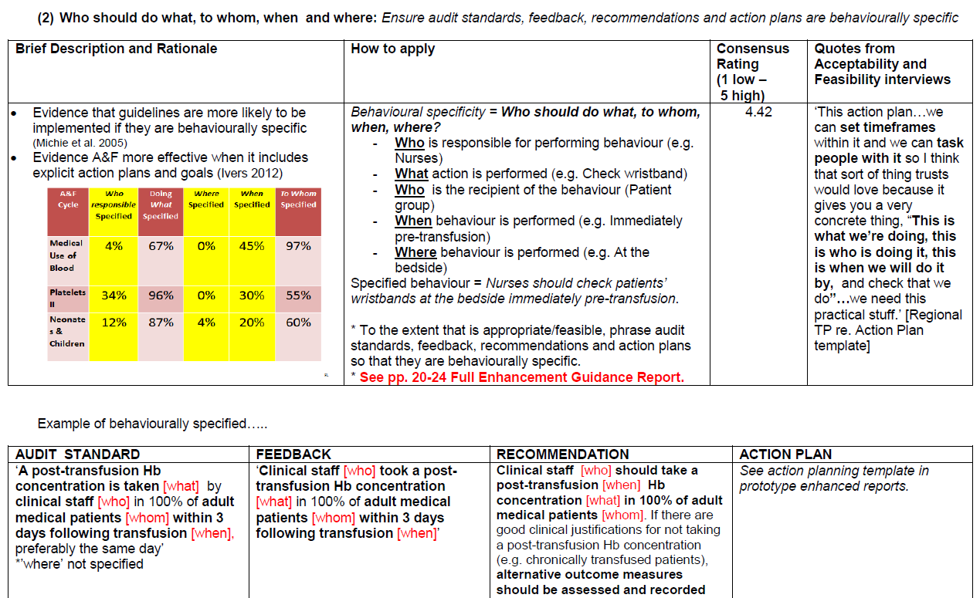
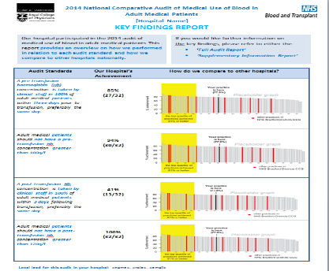
Intervention 1 ‘enhanced CONTENT’: Overview
Theory/Evidence informed enhancements
1. In each feedback report, include at least one BCT related to each component of Control Theory
2. Behaviourally specify audit standards, feedback, recommendations (i.e. Target/ Action/ Context/ Timeframe/Actor)
3. Only deliver feedback explicitly related to an audit standard
4. Include multiple comparators (i.e. national/ regional/ top 10%)
5. If feedback delivered once, conduct rapid re-audit comparing past/present behaviour
6. Include positive feedback (i.e. message of encouragement)
Enhancement guidance manual + template reports: audit writing group
Enhanced feedback reports:
transfusion clinical staff

Slide 28
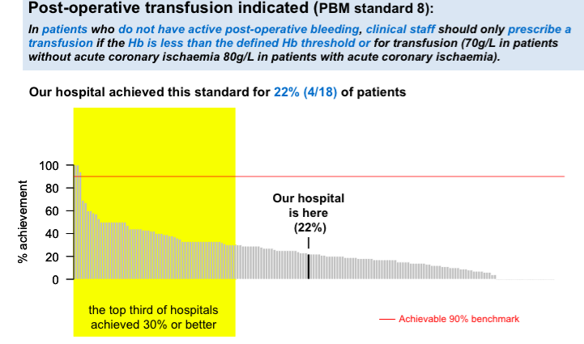

Slide 29
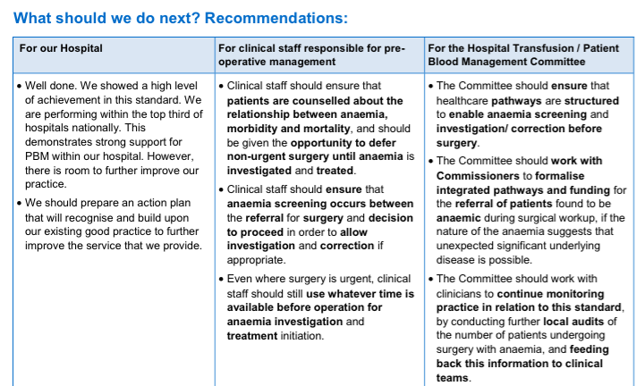

Slide 30


Intervention 2 ‘enhanced FOLLOW ON SUPPORT’: Overview
Behaviour Change Techniques (n=20), including:
Instruction how to perform behaviour
Problem solving
Action planning
Goal-setting (behaviour/ Outcome
Self-monitoring
Behavioural practice/rehearsal
Demonstration of the behaviour
Social reward
Prompts and cues
Social support (practical)
Web-Toolkit
Telephone Support

Slide 31


AFFINITIE Cluster RCT with 2x2 factorial design
UK Hospitals
Trial 1: Surgery
Baseline audit data: Appropriateness of transfusions
N= 155 Sites
Int delivered: Oct 15
Outcome Eval: Oct 16
Writing groups split
Randomisation
Standard Content + Standard Follow On
Enhanced Content + Standard Follow on
Standard Content
+
Enhanced Follow On
Enhanced Content + EnhancedFollow On
RE-RANDOMIZED BETWEEN TRIALS 1 +2
X
X
X
Trial 2: Haematology
N= 167 Sites
Int delivered: Jul 16
Outcome Eval: Jul17
Follow up audit data (12months): Appropriateness transfusions = outcome data

Slide 32
If only it were so easy…
Aligning timelines
Competing audit activities within the same national audit programme
Perceived equipoise
Contamination
Data quality
Need for considerable mutual investment in building a long-term partnership

Slide 33
Planned outputs
Evidence-based materials and resources to support intervention adaptation and scaling up for other national audits
Clear specifications of intervention components, professionals targeted, fidelity of interventions, and mechanisms of change

Slide 34
Optimising the outputs of National Clinical Audits (NIHR HS&DR 16/04)
AIM: To improve patient care by optimising the content, format and delivery of feedback from national clinical audits
OBJECTIVES:
To develop and evaluate feedback modifications, within a web-based randomised screening experiment
To evaluate how different feedback modifications from national audit programmes are delivered, perceived and acted upon in healthcare organisations
To explore the opportunities, costs and benefits of UK national audit programme participation in a long-term international collaborative to improve audits through a programme of trials

Slide 35
Realising the potential of audit and feedback
Evidence-based audit and feedback
AFFINITIE and beyond
Effects of selected QI approaches

Slide 36

Printed educational materials
12 randomised trials; 11 non-randomised studies
Process of care (e.g. x-ray requests, prescribing): Median absolute improvement 4.3 % (interquartile range −8.0 % to +9.6 %) Patient outcomes (e.g. depression scores, smoking cessation): No benefits
Relatively cheap Potential for enhancing effects using ‘persuasive communication’ methods?
Farmer et al. Printed educational materials: effects on professional practice and health care outcomes. Cochrane Database of Systematic Reviews 2008, Issue 3. Art. No.: CD004398. DOI: 10.1002/14651858.CD004398.pub2

Slide 37

Educational meetings
81 randomised trials
Process of care: 6.0% (1.8% to 15.3%) Patient achievement of treatment goals: 3.0% (0.1% to 4.0%) Larger effects with higher attendance rates and interactive meetings Smaller effects for complex behaviours
Commonly used and generally feasible Main cost is release time for professionals
Forsetlund et al. Continuing education meetings and workshops: effects on professional practice and health care outcomes. Cochrane Database of Systematic Reviews 2009, Issue 2. Art. No.: CD003030. DOI: 10.1002/14651858.CD003030.pub2.

Slide 38

Computerised reminders
28 randomised trials
Process of care: 4.2% (0.8% to 18.8%) Clinical end-points (e.g. BP control): 2.5% improvement (1.3% to 4.2%)
Most studies examined the effects of relatively simple reminders More complex decision support less successful, especially for chronic disease management
Shojania et al. The effects of on-screen, point of care computer reminders on processes and outcomes of care. Cochrane Database Syst Reviews 2009, Issue 3. Art. No:CD001096. DOI: 10.1002/14651858.CD001096.pub2

Slide 39

Computerised reminders
28 randomised trials
Process of care: 4.2% (0.8% to 18.8%) Clinical end-points (e.g. BP control): 2.5% improvement (1.3% to 4.2%)
Systems more likely to succeed if… Provided advice for patients in addition to practitioners (OR 2.8, 1.1 to 7.2) Required practitioners to supply a reason for over-riding advice (11.3, 2.0 to 63.7) Evaluated by their developers (4.4, 1.7 to 11.4)
Shojania et al. The effects of on-screen, point of care computer reminders on processes and outcomes of care. Cochrane Database Syst Reviews 2009, Issue 3. Art. No:CD001096. DOI: 10.1002/14651858.CD001096.pub2 Roshanov et al. Features of effective computerised clinical decision support systems: meta-regression of 162 randomised trials. BMJ 2013;346:f657

Slide 40



Strategies to improve organisational culture
“It is not possible to draw any conclusions about the effectiveness of strategies to change organisational culture because we found no studies that fulfilled the methodological criteria for this review.”
Parmelli E, Flodgren G, Schaafsma ME, Baillie N, Beyer FR, Eccles MP. The effectiveness of strategies to change organisational culture to improve healthcare performance. Cochrane Database of Systematic Reviews 2011, Issue 1. Art. No.: CD008315. DOI: 10.1002/14651858.CD008315.pub2.

Slide 41

Are modest effect sizes worthwhile?
Effect sizes in range of those for many recommended clinical treatments
Population impact potentially worthwhile in relation to costs of interventions
Effects of quality improvement interventions cumulative and complementary…

Slide 42

… but not necessarily
Grimshaw et al. Effectiveness and efficiency of guideline dissemination and implementation strategies. Health Technol Assess 2004; 8(6)
Notes:
Whilst it might also be expected that multiple interventions might be more effective than single interventions, the above review did not identify an obvious pattern. However, there might be other confounding effects at work here. For example, investigators anticipating greater resistance to change might have been more likely to ‘throw in the kitchen sink’ (i.e. to use multiple interventions to overcome multiple barriers).

Slide 43
Realising the potential of audit and feedback
Evidence-based audit and feedback
AFFINITIE and beyond
Effects of selected QI approaches

Slide 44

Advancing the science and impact of audit and feedback
International A&F Collaborative
International community of health researchers and health system partners that undertake shared activities to enhance the provision of audit and feedback to improve health care performance, patient outcomes and health system sustainability
Established Canada
April 2016
Next meeting Leeds, UK
6-7 June 2017

